Slide 1
19
The Cardiovascular System: Blood Vessels: Part B

Slide 2
Monitoring Circulatory Efficiency
Vital signs: pulse and blood pressure, along with respiratory rate and body temperature
Pulse: pressure wave caused by the expansion and recoil of arteries
Radial pulse (taken at the wrist) routinely used

Slide 3
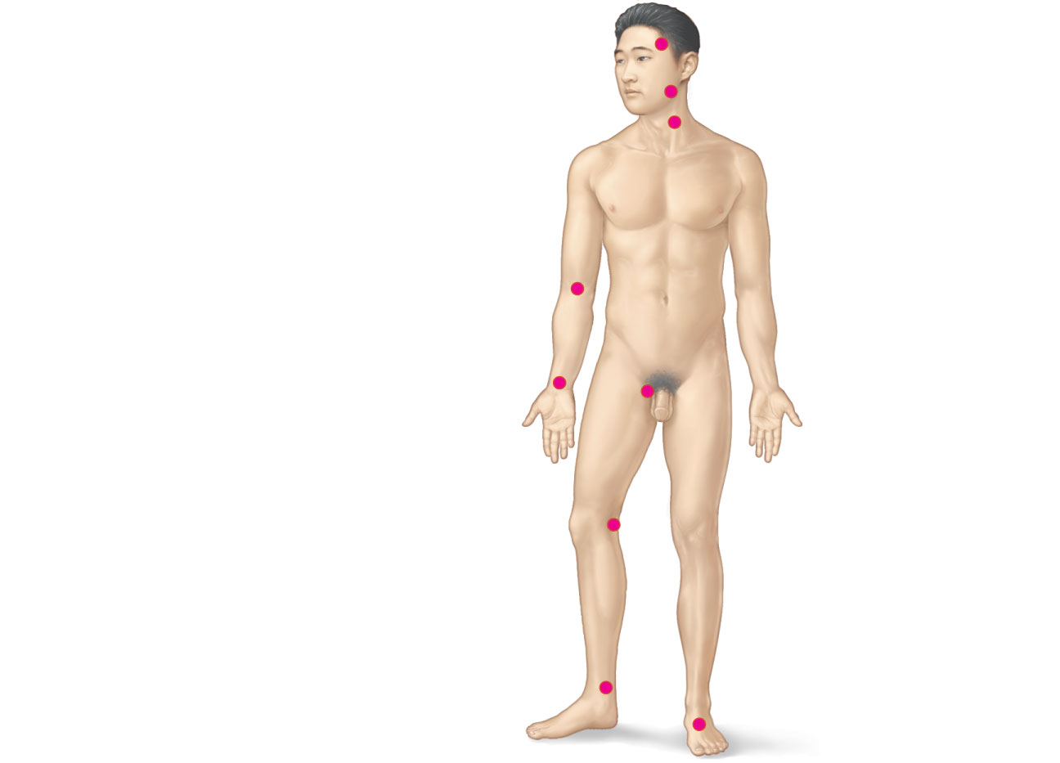
Superficial temporal
artery
Facial artery
Common carotid
artery
Brachial artery
Radial artery
Femoral artery
Popliteal artery
Posterior tibial
artery
Dorsalis pedis
artery
Figure 19.12

Slide 4
Measuring Blood Pressure
Systemic arterial BP
  Measured indirectly by the auscultatory method using a sphygmomanometer
  Pressure is increased in the cuff until it exceeds systolic pressure in the brachial artery

Slide 5
Measuring Blood Pressure
Pressure is released slowly and the examiner listens for sounds of Korotkoff with a stethoscope
Sounds first occur as blood starts to spurt through the artery (systolic pressure, normally 110–140 mm Hg)
Sounds disappear when the artery is no longer constricted and blood is flowing freely (diastolic pressure, normally 70–80 mm Hg)

Slide 6
Variations in Blood Pressure
Blood pressure cycles over a 24-hour period
BP peaks in the morning due to levels of hormones
Age, sex, weight, race, mood, and posture may vary BP

Slide 7
Alterations in Blood Pressure
Hypotension: low blood pressure
  Systolic pressure below 100 mm Hg
  Often associated with long life and lack of cardiovascular illness

Slide 8
Homeostatic Imbalance: Hypotension
Orthostatic hypotension: temporary low BP and dizziness when suddenly rising from a sitting or reclining position
Chronic hypotension: hint of poor nutrition and warning sign for Addison’s disease or hypothyroidism
Acute hypotension: important sign of circulatory shock

Slide 9
Alterations in Blood Pressure
Hypertension: high blood pressure
  Sustained elevated arterial pressure of 140/90 or higher
    May be transient adaptations during fever, physical exertion, and emotional upset
    Often persistent in obese people

Slide 10
Homeostatic Imbalance: Hypertension
Prolonged hypertension is a major cause of heart failure, vascular disease, renal failure, and stroke
Primary or essential hypertension
  90% of hypertensive conditions
  Due to several risk factors including heredity, diet, obesity, age, stress, diabetes mellitus, and smoking

Slide 11
Homeostatic Imbalance: Hypertension
Secondary hypertension is less common
  Due to identifiable disorders, including kidney disease, arteriosclerosis, and endocrine disorders such as hyperthyroidism and Cushing’s syndrome

Slide 12
Blood Flow Through Body Tissues
Blood flow (tissue perfusion) is involved in
  Delivery of O₂ and nutrients to, and removal of wastes from, tissue cells
  Gas exchange (lungs)
  Absorption of nutrients (digestive tract)
  Urine formation (kidneys)
Rate of flow is precisely the right amount to provide for proper function

Slide 13
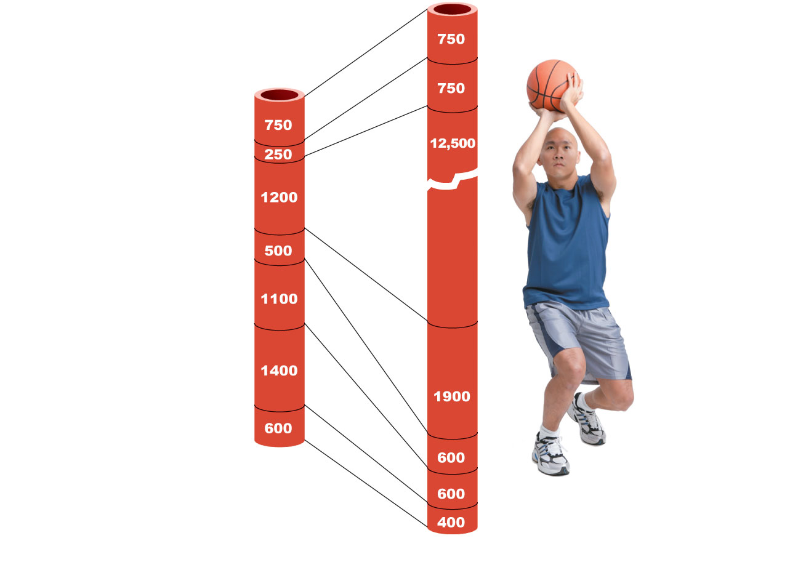
Brain
Heart
Skeletal
muscles
Skin
Kidney
Abdomen
Other
Total blood
flow at rest
5800 ml/min
Total blood flow during strenuous
exercise 17,500 ml/min
Figure 19.13

Slide 14
Velocity of Blood Flow
Changes as it travels through the systemic circulation
Is inversely related to the total cross-sectional area
Is fastest in the aorta, slowest in the capillaries, increases again in veins
Slow capillary flow allows adequate time for exchange between blood and tissues

Slide 15
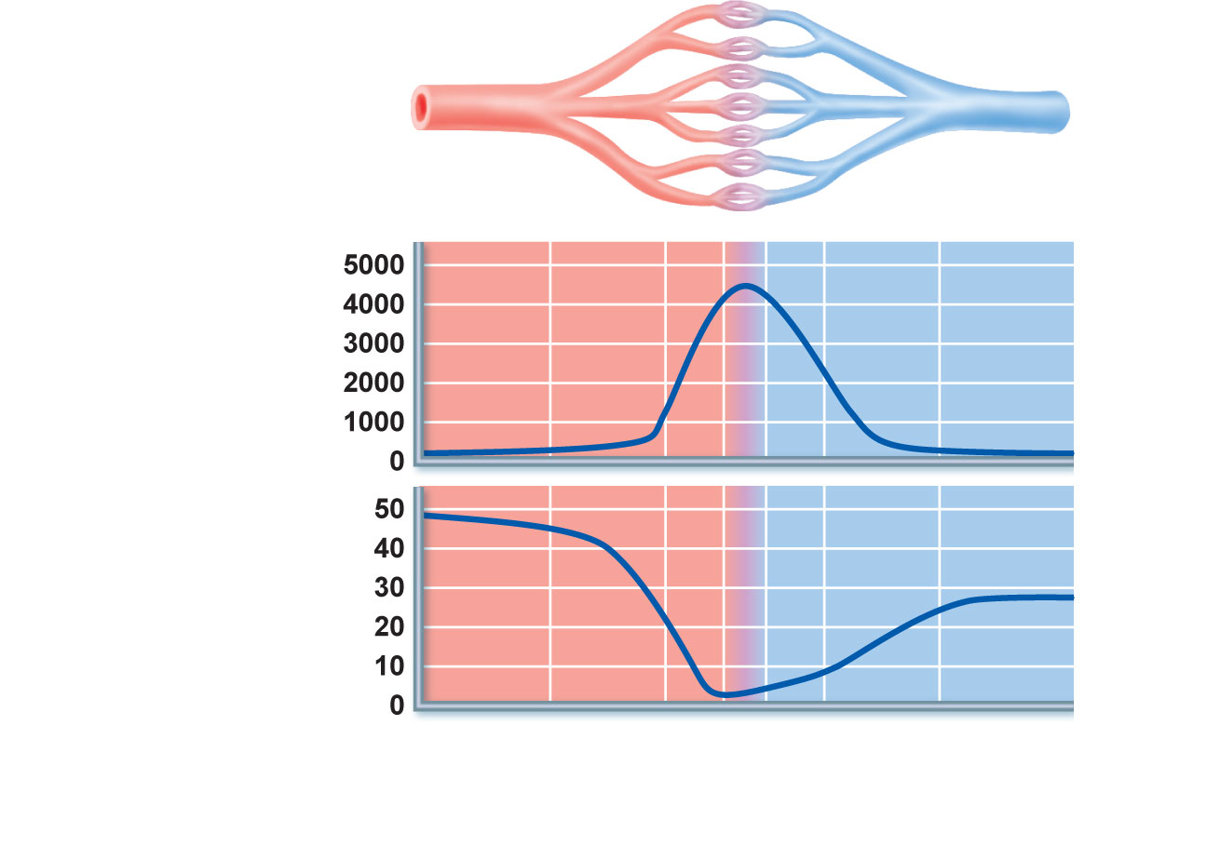
Relative cross-
sectional area of
different vessels
of the vascular bed
Total area
(cm²) of the
vascular
bed
Velocity of
blood flow
(cm/s)
Aorta
Arteries
Venules
Veins
Arterioles
Capillaries
Venae cavae
Figure 19.14

Slide 16
Autoregulation
Automatic adjustment of blood flow to each tissue in proportion to its requirements at any given point in time
Is controlled intrinsically by modifying the diameter of local arterioles feeding the capillaries
Is independent of MAP, which is controlled as needed to maintain constant pressure

Slide 17
Autoregulation
Two types of autoregulation
  Metabolic
  Myogenic

Slide 18
Metabolic Controls
Vasodilation of arterioles and relaxation of precapillary sphincters occur in response to
  Declining tissue O₂
  Substances from metabolically active tissues (H⁺, K⁺, adenosine, and prostaglandins) and inflammatory chemicals

Slide 19
Metabolic Controls
Effects
  Relaxation of vascular smooth muscle
  Release of NO from vascular endothelial cells
NO is the major factor causing vasodilation
Vasoconstriction is due to sympathetic stimulation and endothelins

Slide 20
Myogenic Controls
Myogenic responses of vascular smooth muscle keep tissue perfusion constant despite most fluctuations in systemic pressure
Passive stretch (increased intravascular pressure) promotes increased tone and vasoconstriction
Reduced stretch promotes vasodilation and increases blood flow to the tissue

Slide 21
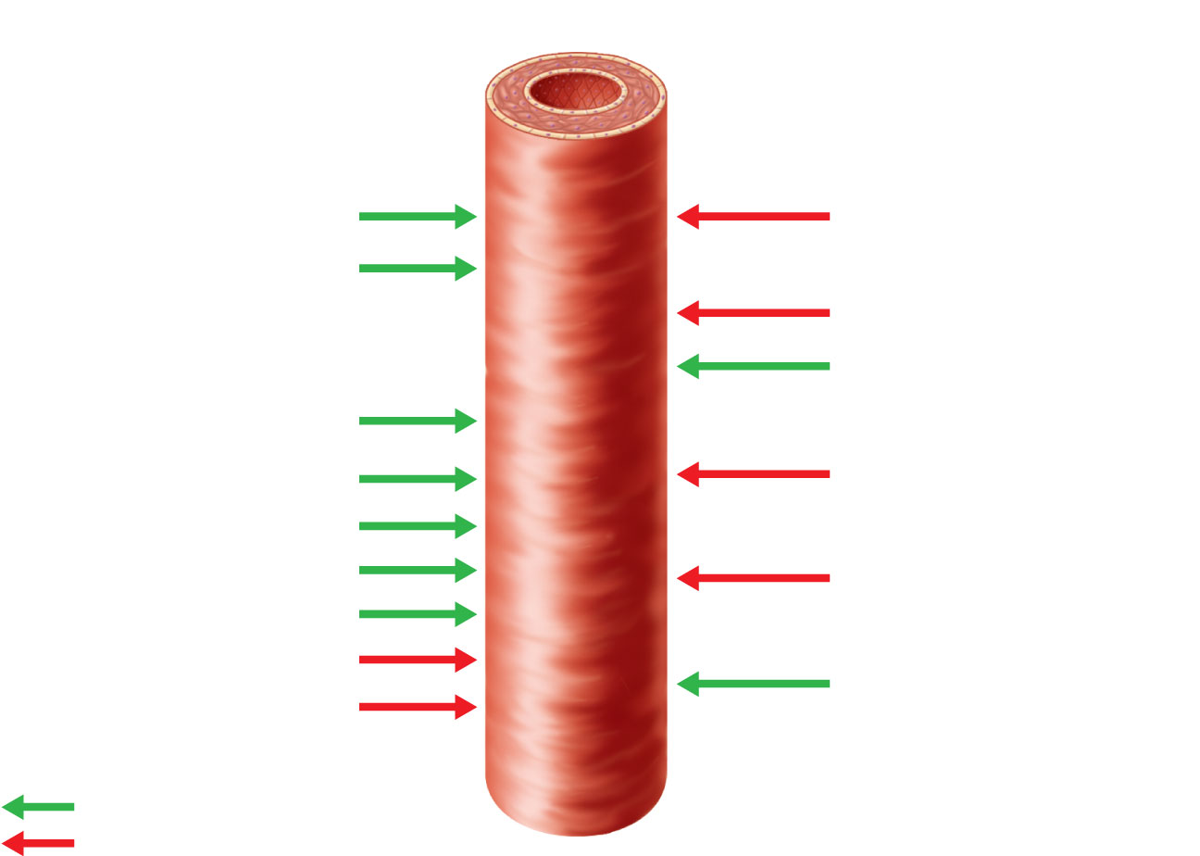
Intrinsic mechanisms
(autoregulation)
Extrinsic mechanisms
• Maintain mean arterial pressure (MAP)
• Redistribute blood during exercise and
thermoregulation
• Distribute blood flow to individual
organs and tissues as needed
Amounts of:
pH
Sympathetic
Nerves
O₂
α Receptors
Metabolic
controls
β Receptors
Epinephrine,
norepinephrine
Amounts of:
CO₂
K⁺
Angiotensin II
Hormones
Prostaglandins
Adenosine
Antidiuretic
hormone (ADH)
Nitric oxide
Endothelins
Atrial
natriuretic
peptide (ANP)
Myogenic
controls
Stretch
Dilates
Constricts
Figure 19.15

Slide 22
Long-Term Autoregulation
Angiogenesis
  Occurs when short-term autoregulation cannot meet tissue nutrient requirements
  The number of vessels to a region increases and existing vessels enlarge
  Common in the heart when a coronary vessel is occluded, or throughout the body in people in high-altitude areas

Slide 23
Blood Flow: Skeletal Muscles
At rest, myogenic and general neural mechanisms predominate
During muscle activity
  Blood flow increases in direct proportion to the metabolic activity (active or exercise hyperemia)
  Local controls override sympathetic vasoconstriction
Muscle blood flow can increase 10× or more during physical activity

Slide 24
Blood Flow: Brain
Blood flow to the brain is constant, as neurons are intolerant of ischemia
Metabolic controls
  Declines in pH, and increased carbon dioxide cause marked vasodilation
Myogenic controls
  Decreases in MAP cause cerebral vessels to dilate
  Increases in MAP cause cerebral vessels to constrict

Slide 25
Blood Flow: Brain
The brain is vulnerable under extreme systemic pressure changes
  MAP below 60 mm Hg can cause syncope (fainting)
  MAP above 160 can result in cerebral edema

Slide 26
Blood Flow: Skin
Blood flow through the skin
  Supplies nutrients to cells (autoregulation in response to O₂ need)
  Helps maintain body temperature (neurally controlled)
  Provides a blood reservoir (neurally controlled)

Slide 27
Blood Flow: Skin
Blood flow to venous plexuses below the skin surface
  Varies from 50 ml/min to 2500 ml/min, depending on body temperature
  Is controlled by sympathetic nervous system reflexes initiated by temperature receptors and the central nervous system

Slide 28
Temperature Regulation
As temperature rises (e.g., heat exposure, fever, vigorous exercise)
  Hypothalamic signals reduce vasomotor stimulation of the skin vessels
  Heat radiates from the skin

Slide 29
Temperature Regulation
Sweat also causes vasodilation via bradykinin in perspiration
  Bradykinin stimulates the release of NO
As temperature decreases, blood is shunted to deeper, more vital organs

Slide 30
Blood Flow: Lungs
Pulmonary circuit is unusual in that
  The pathway is short
  Arteries/arterioles are more like veins/venules (thin walled, with large lumens)
  Arterial resistance and pressure are low (24/8 mm Hg)

Slide 31
Blood Flow: Lungs
Autoregulatory mechanism is opposite of that in most tissues
  Low O₂ levels cause vasoconstriction; high levels promote vasodilation
  Allows for proper O₂ loading in the lungs

Slide 32
Blood Flow: Heart
During ventricular systole
  Coronary vessels are compressed
  Myocardial blood flow ceases
  Stored myoglobin supplies sufficient oxygen
At rest, control is probably myogenic

Slide 33
Blood Flow: Heart
During strenuous exercise
  Coronary vessels dilate in response to local accumulation of vasodilators
  Blood flow may increase three to four times

Slide 34
Blood Flow Through Capillaries
Vasomotion
  Slow and intermittent flow
  Reflects the on/off opening and closing of precapillary sphincters

Slide 35
Capillary Exchange of Respiratory Gases and Nutrients
Diffusion of
  O₂ and nutrients from the blood to tissues
  CO₂ and metabolic wastes from tissues to the blood
Lipid-soluble molecules diffuse directly through endothelial membranes
Water-soluble solutes pass through clefts and fenestrations
Larger molecules, such as proteins, are actively transported in pinocytotic vesicles or caveolae

Slide 36
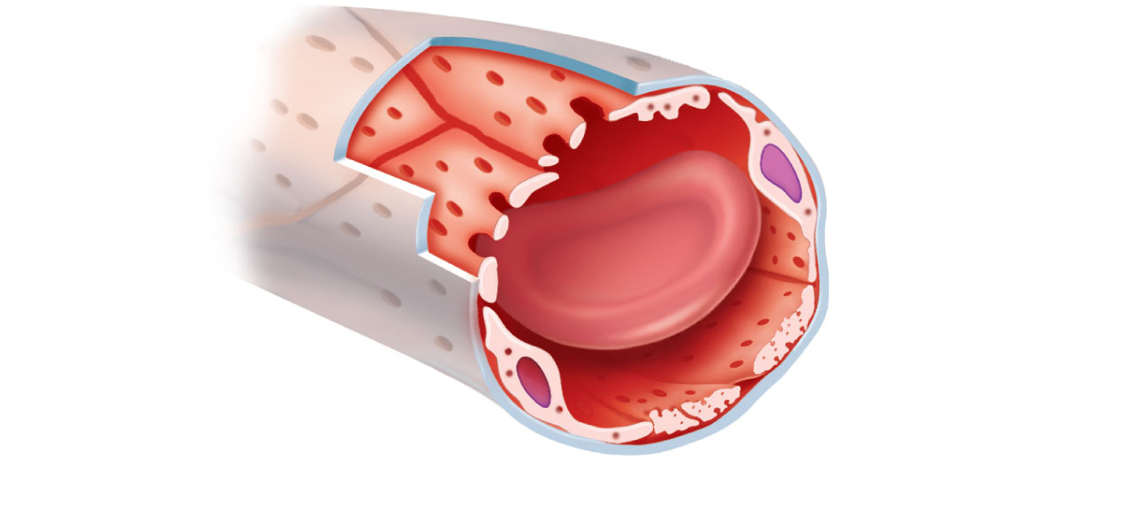
Pinocytotic vesicles
Red blood
cell in lumen
Endothelial cell
Fenestration
(pore)
Endothelial cell nucleus
Basement membrane
Tight junction
Intercellular cleft
Figure 19.16 (1 of 2)

Slide 37
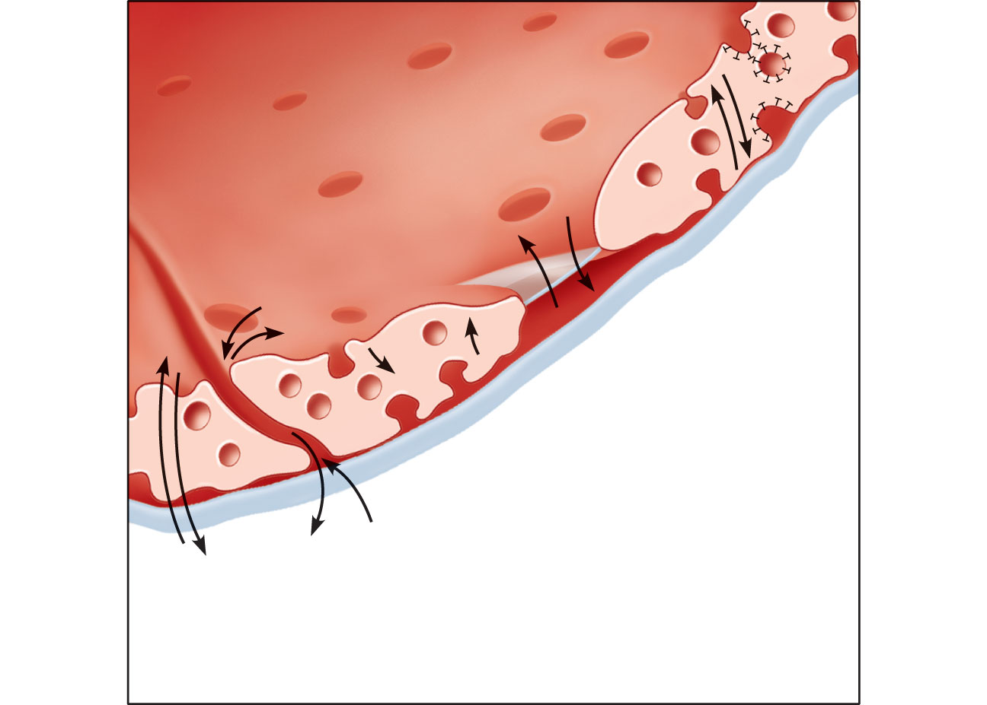
Lumen
Caveolae
Pinocytotic
vesicles
Endothelial
fenestration
(pore)
Intercellular
cleft
4
Transport
via vesicles or
caveolae (large
substances)
3
Movement
through
fenestrations
(water-soluble
substances)
Basement
membrane
2
Movement
through intercellular
clefts (water-soluble
substances)
1
Diffusion
through
membrane
(lipid-soluble
substances)
Figure 19.16 (2 of 2)

Slide 38
Fluid Movements: Bulk Flow
Extremely important in determining relative fluid volumes in the blood and interstitial space
Direction and amount of fluid flow depends on two opposing forces: hydrostatic and colloid osmotic pressures

Slide 39
Hydrostatic Pressures
Capillary hydrostatic pressure (HP_{c}) (capillary blood pressure)
  Tends to force fluids through the capillary walls
  Is greater at the arterial end (35 mm Hg) of a bed than at the venule end (17 mm Hg)
Interstitial fluid hydrostatic pressure (HP_{if})
  Usually assumed to be zero because of lymphatic vessels

Slide 40
Colloid Osmotic Pressures
Capillary colloid osmotic pressure (oncotic pressure) (OP_{c})
  Created by nondiffusible plasma proteins, which draw water toward themselves
  ~26 mm Hg
Interstitial fluid osmotic pressure (OP_{if})
  Low (~1 mm Hg) due to low protein content

Slide 41
Net Filtration Pressure (NFP)
NFP—comprises all the forces acting on a capillary bed
NFP = (HP_{c}—HP_{if})—(OP_{c}—OP_{if})
At the arterial end of a bed, hydrostatic forces dominate
At the venous end, osmotic forces dominate
Excess fluid is returned to the blood via the lymphatic system

Slide 42
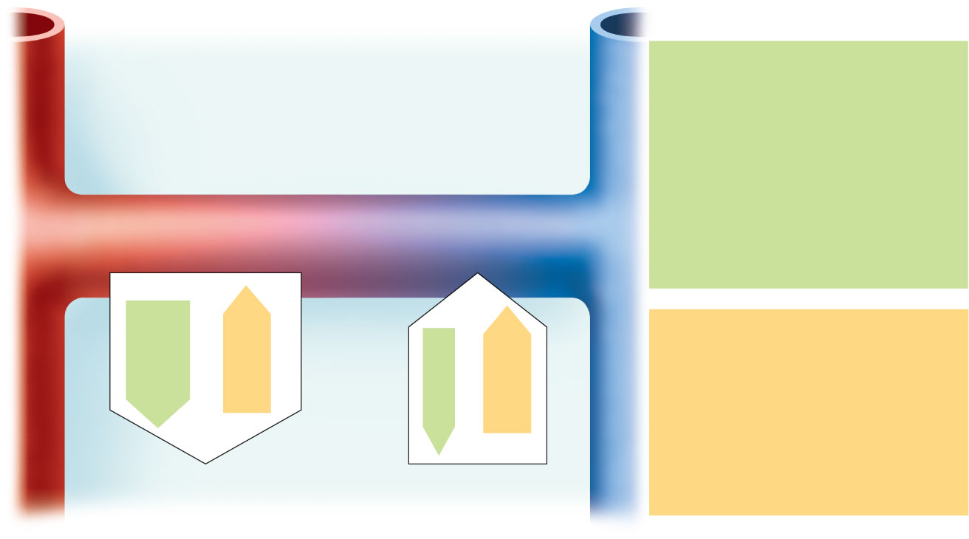
HP = hydrostatic pressure
• Due to fluid pressing against a wall
• “Pushes”
• In capillary (HP_{c})
• Pushes fluid out of capillary
• 35 mm Hg at arterial end and
17 mm Hg at venous end of
capillary in this example
• In interstitial fluid (HP_{if})
• Pushes fluid into capillary
• 0 mm Hg in this example
Arteriole
Venule
Interstitial fluid
Capillary
Net HP—Net OP
(35—0)—(26—1)
Net HP—Net OP
(17—0)—(26—1)
Net
HP
35
mm
Net
OP
25
mm
OP = osmotic pressure
• Due to presence of nondiffusible
solutes (e.g., plasma proteins)
• “Sucks”
• In capillary (OP_{c})
• Pulls fluid into capillary
• 26 mm Hg in this example
• In interstitial fluid (OP_{if})
• Pulls fluid out of capillary
• 1 mm Hg in this example
Net
HP
17
mm
Net
OP
25
mm
NFP (net filtration pressure)
is 10 mm Hg; fluid moves out
NFP is ~8 mm Hg;
fluid moves in
Figure 19.17

Slide 43
Circulatory Shock
Any condition in which
  Blood vessels are inadequately filled
  Blood cannot circulate normally
Results in inadequate blood flow to meet tissue needs

Slide 44
Circulatory Shock
Hypovolemic shock: results from large-scale blood loss
Vascular shock: results from extreme vasodilation and decreased peripheral resistance
Cardiogenic shock results when an inefficient heart cannot sustain adequate circulation

Slide 45
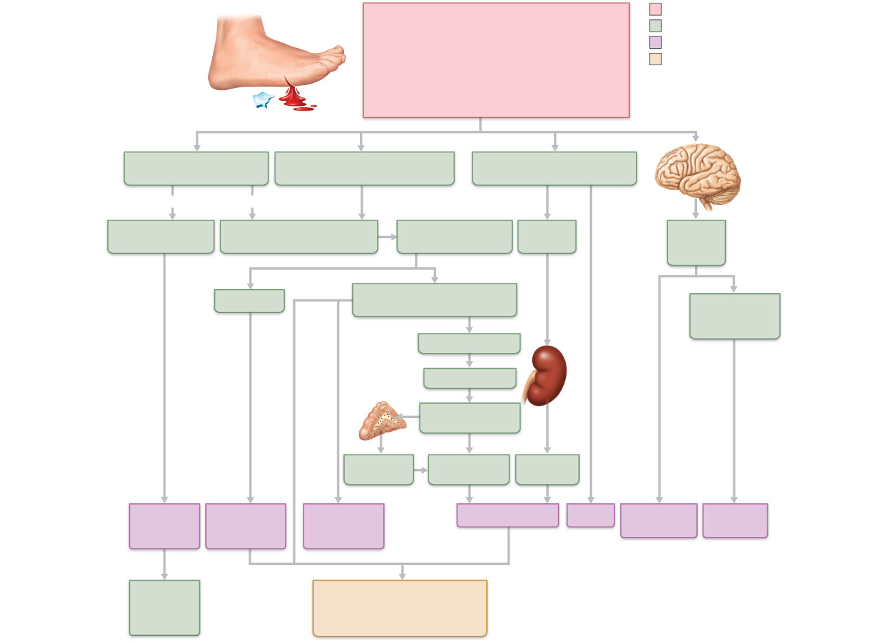
Acute bleeding (or other events that cause
blood volume loss) leads to:
Initial stimulus
1. Inadequate tissue perfusion
resulting in O₂ and nutrients to cells
2. Anaerobic metabolism by cells, so lactic
acid accumulates
3. Movement of interstitial fluid into blood,
so tissues dehydrate
Physiological response
Signs and symptoms
Result
Chemoreceptors activated
(by in blood pH)
Baroreceptor firing reduced
(by blood volume and pressure)
Hypothalamus activated
(by pH and blood pressure)
Brain
Major effect
Minor effect
Activation of
respiratory centers
Cardioacceleratory and
vasomotor centers activated
Sympathetic nervous
system activated
ADH
released
Neurons
depressed
by pH
Heart rate
Intense vasoconstriction
(only heart and brain spared)
Central
nervous system
depressed
Renal blood flow
Kidney
Adrenal
cortex
Renin released
Angiotensin II
produced in blood
Aldosterone
released
Kidneys retain
salt and water
Water
retention
Rate and
depth of
breathing
Tachycardia,
weak, thready
pulse
Skin becomes
cold, clammy,
and cyanotic
Urine output
Thirst
Restlessness
(early sign)
Coma
(late sign)
CO₂ blown
off; blood
pH rises
Blood pressure maintained;
if fluid volume continues to
decrease, BP ultimately
drops. BP is a late sign.
Figure 19.18

Slide 46
Circulatory Pathways
Two main circulations
  Pulmonary circulation: short loop that runs from the heart to the lungs and back to the heart
  Systemic circulation: long loop to all parts of the body and back to the heart

Slide 47
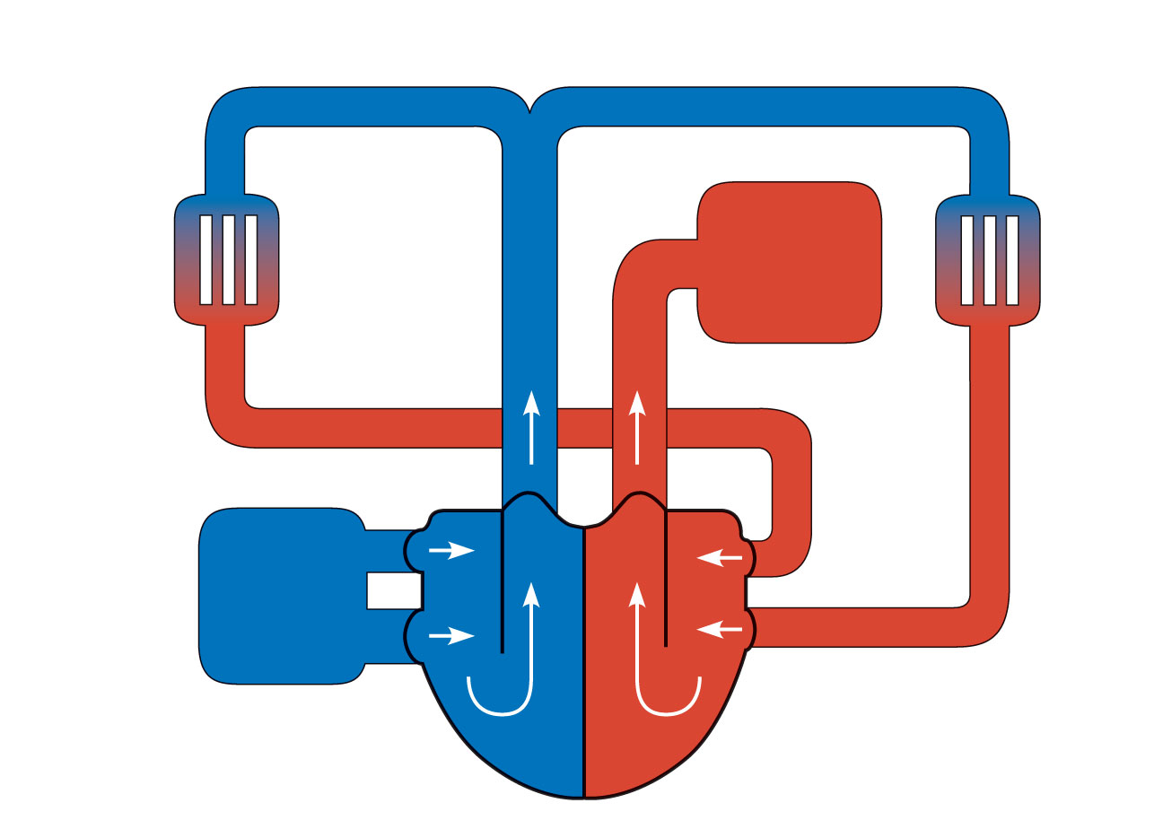
Pulmonary capillaries
of the R. lung
R. pulmonary
artery
L. pulmonary
artery
Pulmonary capillaries
of the L. lung
Pulmonary
trunk
To
systemic
circulation
R. pulmon-
ary veins
From
systemic
circulation
RA
LA
L. pulmonary
veins
RV
LV
(a) Schematic flowchart.
Figure 19.19a

Slide 48
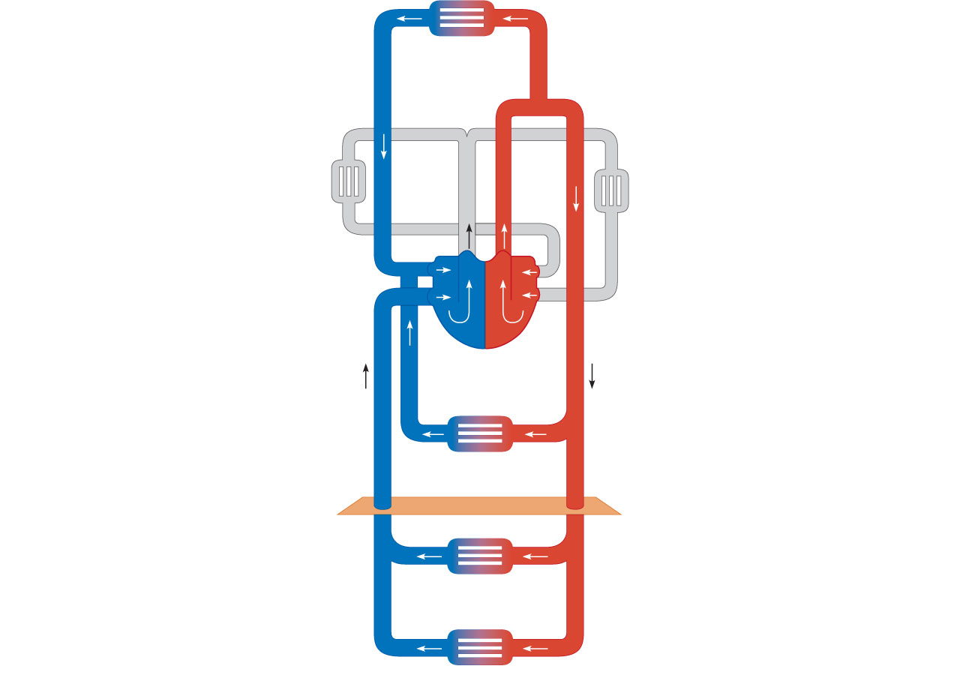
Capillary beds of
head and
upper limbs
Common
carotid arteries
to head and
subclavian
arteries to
upper limbs
Superior
vena cava
Aortic
arch
Aorta
RA
LA
RV
LV
Azygos
system
Thoracic
aorta
Venous
drainage
Arterial
blood
Inferior
vena
cava
Capillary beds of
mediastinal structures
and thorax walls
Diaphragm
Abdominal
aorta
Inferior
vena
cava
Capillary beds of
digestive viscera,
spleen, pancreas,
kidneys
Capillary beds of gonads,
pelvis, and lower limbs
Figure 19.20

Slide 49
Differences Between Arteries and Veins
 | Arteries | Veins
Delivery | Blood pumped into single systemic artery—the aorta | Blood returns via superior and interior venae cavae and the coronary sinus
Location | Deep, and protected by tissues | Both deep and superficial
Pathways | Fairly distinct | Numerous interconnections
Supply/drainage | Predictable supply | Usually similar to arteries, except dural sinuses and hepatic portal circulation

Slide 50
Developmental Aspects
Endothelial lining arises from mesodermal cells in blood islands
Blood islands form rudimentary vascular tubes, guided by cues such as vascular endothelial growth factor
The heart pumps blood by the 4th week of development

Slide 51
Developmental Aspects
Fetal shunts (foramen ovale and ductus arteriosus) bypass nonfunctional lungs
Ductus venosus bypasses the liver
Umbilical vein and arteries circulate blood to and from the placenta

Slide 52
Developmental Aspects
Vessel formation occurs
  To support body growth
  For wound healing
  To rebuild vessels lost during menstrual cycles
With aging, varicose veins, atherosclerosis, and increased blood pressure may aris

